Slide 1
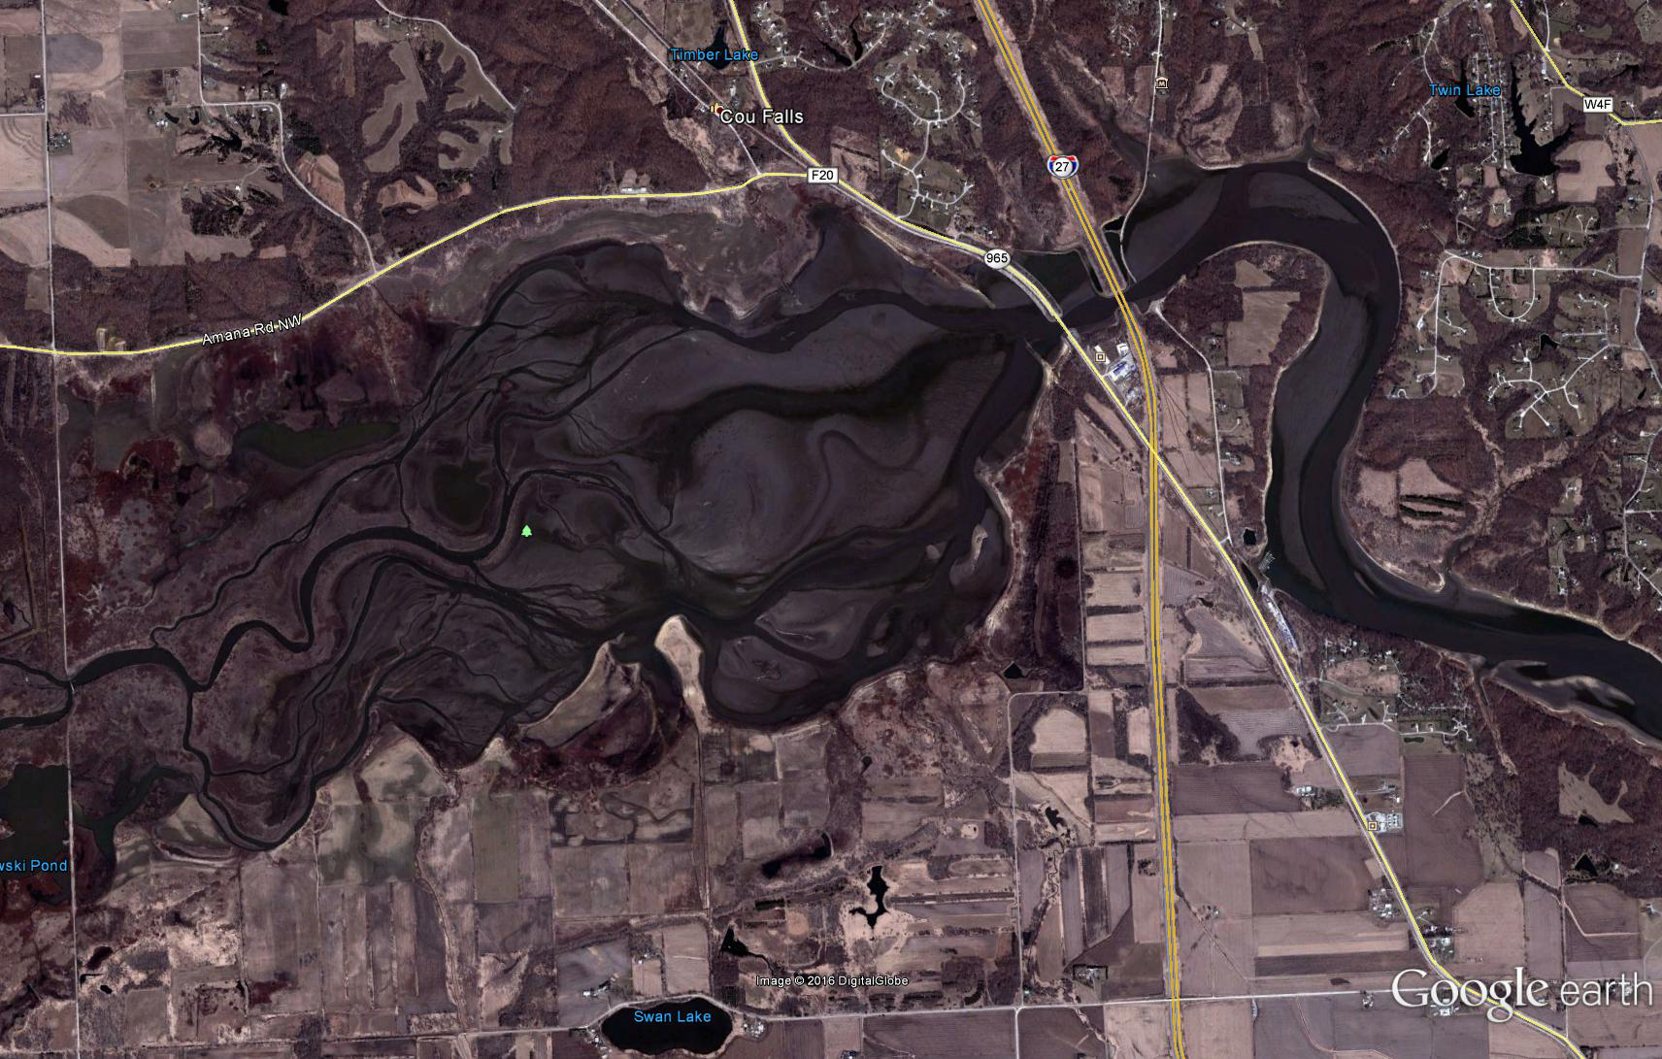
Sedimentation in Coralville Lake
Kevin Landwehr
Chief, Hydrology and Hydraulics Branch
16 May 2018

Slide 2
AGENDA
Geneal Reservoir Sedimentation Overview
Historical Sedimentation Rates at Coralville Lake
Impact on Authorized Operating Purposes – focus on FRM and low-flow augmentation.

Slide 3
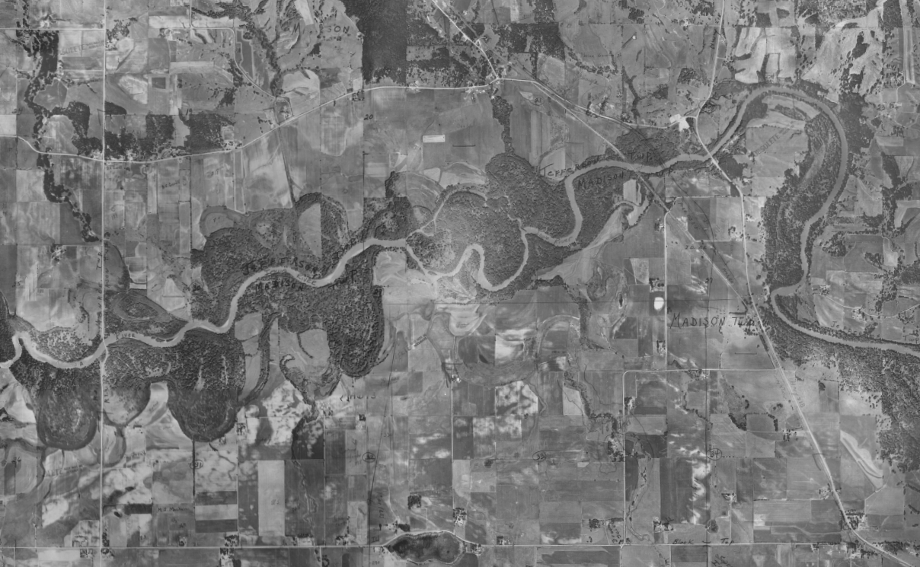
Pre Coralville Dam
1950’s

Slide 4
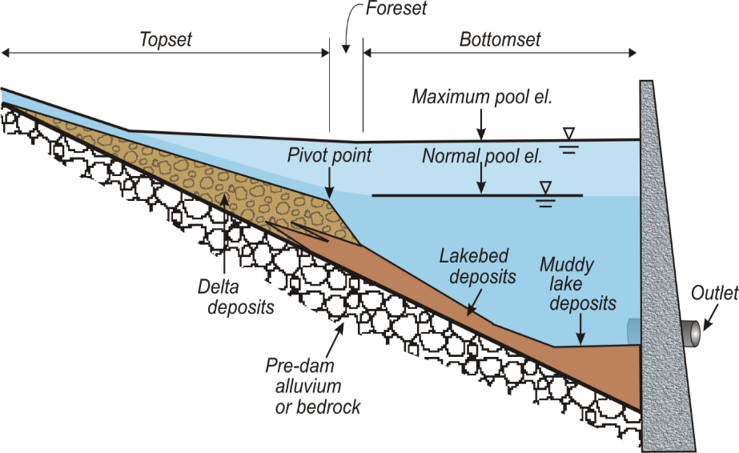
Reservoir Sedimentation

Slide 5
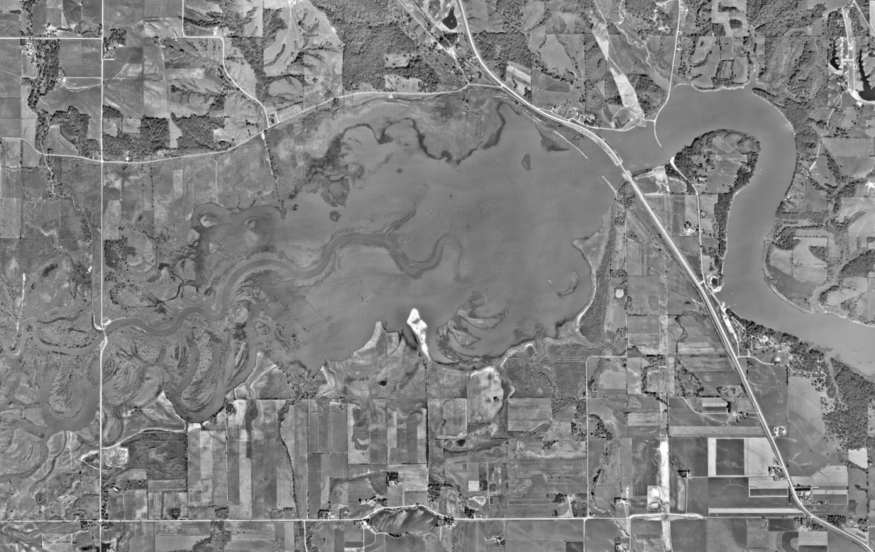
1970’s

Slide 6
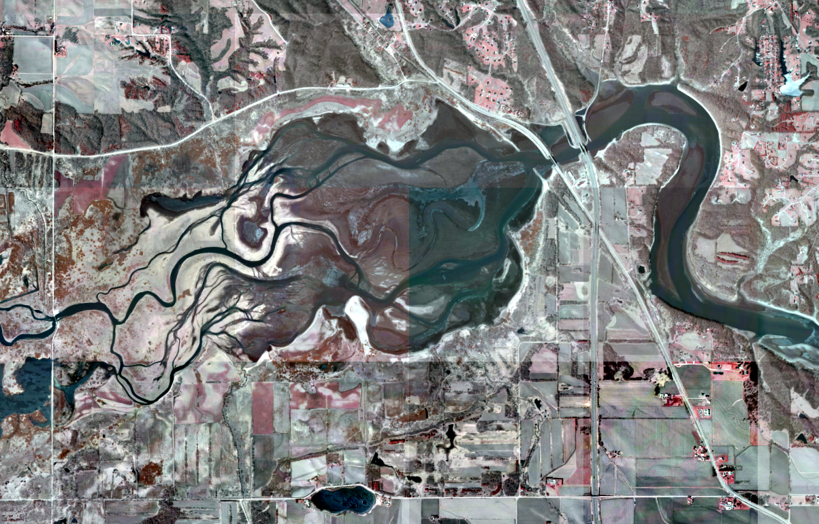
2002

Slide 7
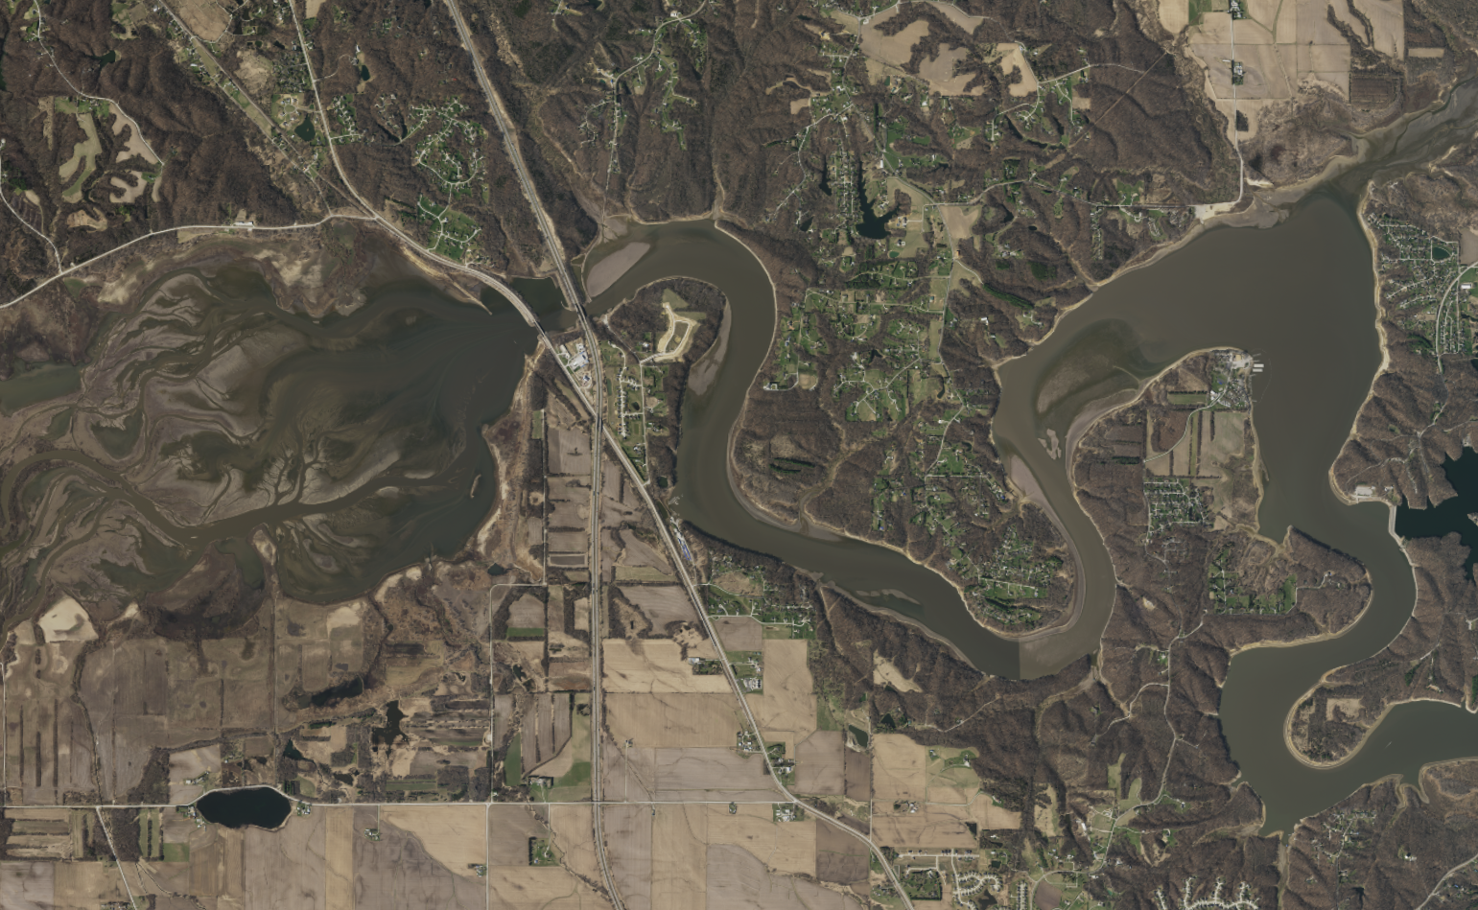
Progression of delta at upstream end of conservation pool
2016

Slide 8
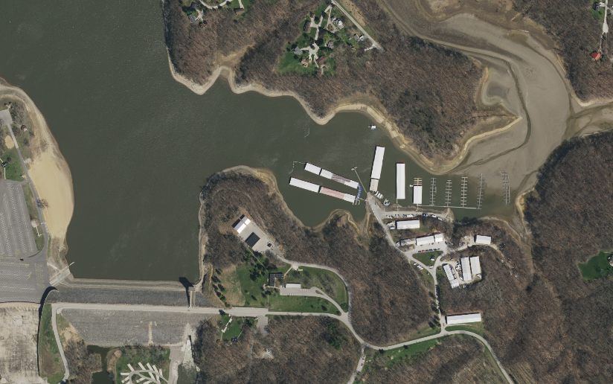
Progression of delta at upstream end of conservation pool
2016

Slide 9
Reservoir Sedimentation
Sedimentation was anticipated as part of original reservoir design.
Greatest impact is to conservation storage, impacting: drought management, fish and wildlife management, and recreation.
2016

Slide 10
Multi-Purpose Reservoir Planning
Sediment design life (typically 50 or 100 years)
Estimate the reservoir sedimentation volume over the sediment design life
What happens after sediment design life was not addressed
USACE has responded to sedimentation at Coralville Lake through a raise in the conservation pool elevation from 680 to 683 feet (earlier spring flood pool elevation was 670/675).

Slide 11
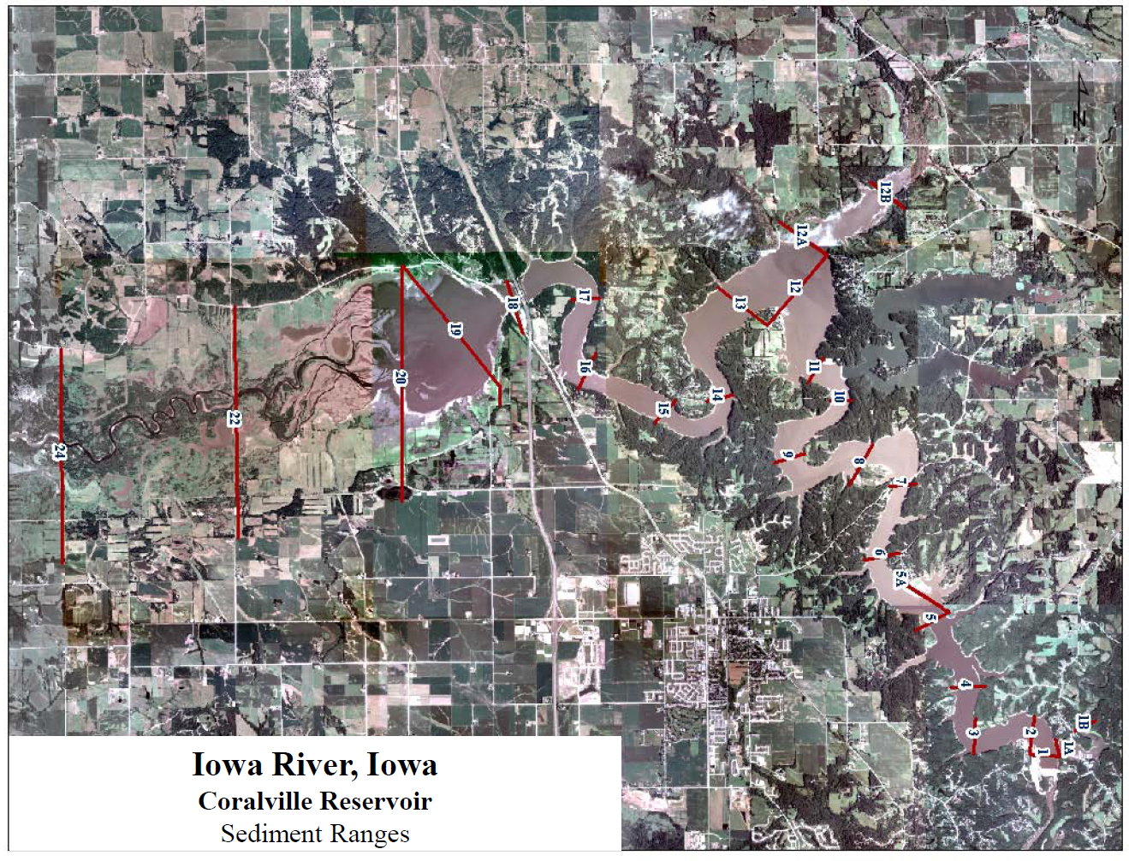
Historical sedimentation surveys
Surveys conducted in:
1958
1964
1975
1983
1999
2008
Methodology used remained consistent through 1983. In 1999 GIS was utilized to process survey data and the 2008 survey utilized LiDAR information for capacity above the conservation pool.

Slide 12
Coralville Lake Sedimentation Rates
For the period 1959 – 2008, the average rate of sedimentation was approximately 1,600 acre-feet per year.
From 1959 to 2008, the conservation storage volume (below elevation 683 feet) decreased from 67,000 acre-ft to 23,800 acre-ft.
36% of original volume remaining
From 1959 to 2008, the flood control storage volume (between elevation 683 and 712 feet) decreased from 409,000 acre-ft to 372,000 acre-ft.
91% of original volume remaining
Overtime, the rate of sedimentation in the conservation pool has decreased, while the rate of sedimentation in the flood pool has increased. The overall rate of sedimentation has remained fairly consistent.
The estimated sediment trap efficiency for
Coralville Lake is 72%

Slide 13
Coralville lake sedimentation rates
The observed average rate of sedimentation in Coralville Lake is 1,600 acre-ft per year. This is equivalent to:
Sediment placed 16 feet deep over a 100 acre piece of land.
Approximately two Empire State Buildings (1,700 acre-ft)

Slide 14
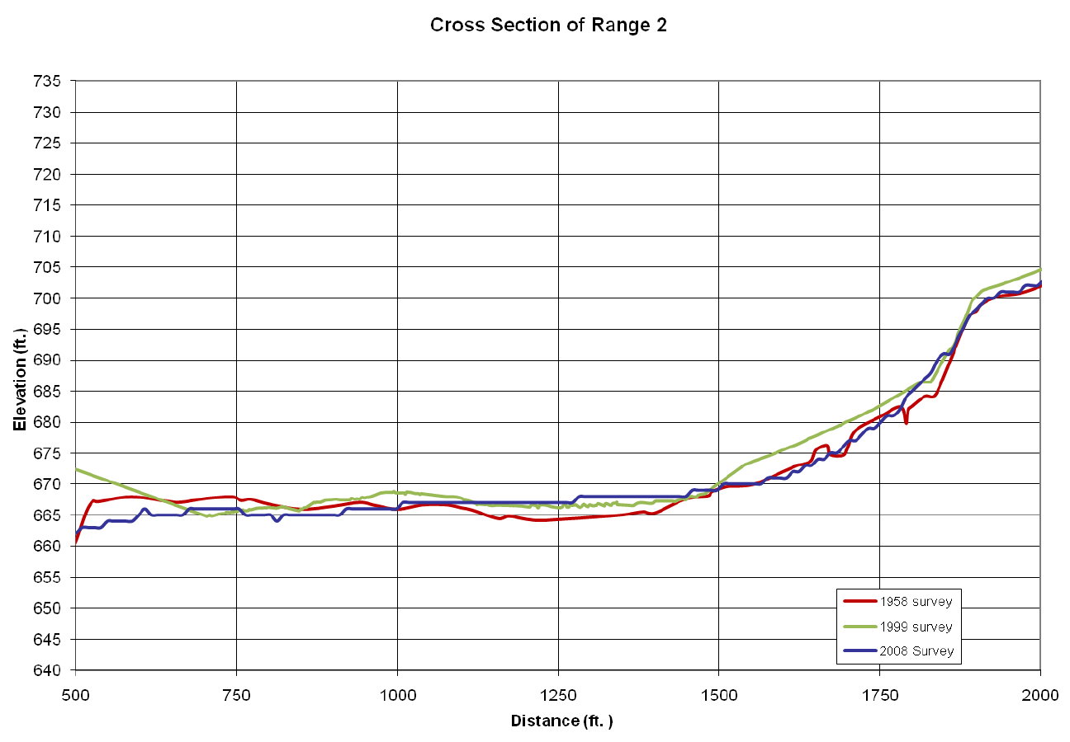
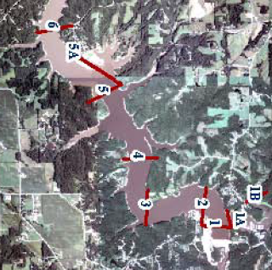
Reservoir Sediment Ranges – Range 2

Slide 15
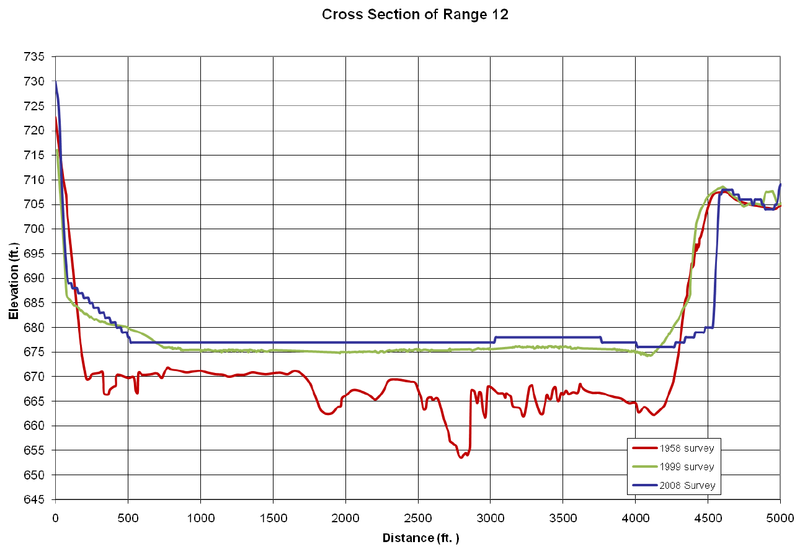
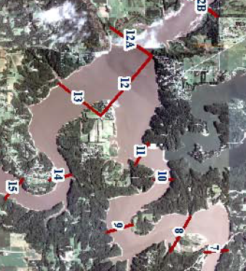
Reservoir Sediment Ranges – Range 12

Slide 16
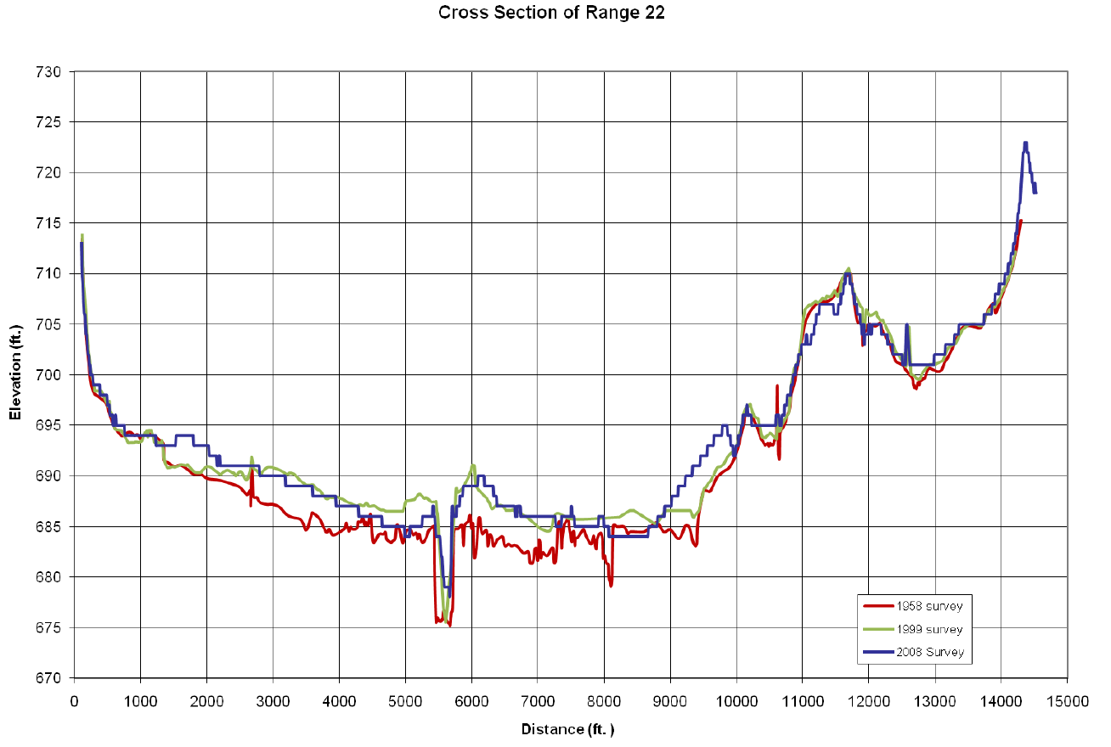
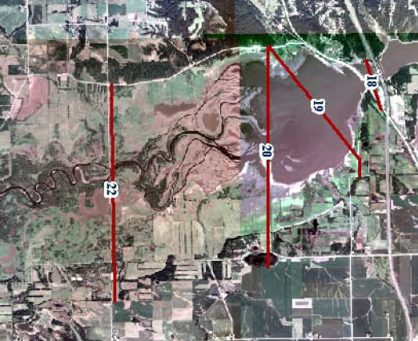
Reservoir Sediment Ranges – Range 22

Slide 17
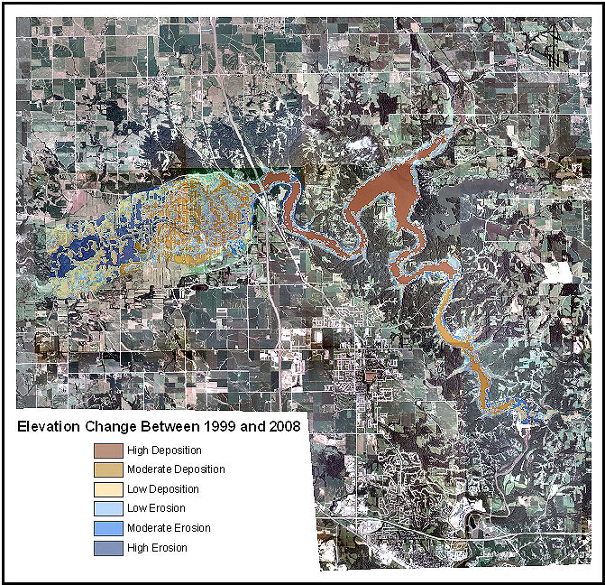

Slide 18
IMPACTS OF SEDIMENTAION -
CONGRESSIONALLY AUTHORIZED PURPOSES
Coralville Lake:
Flood Risk Management (Primary) – PL 75-761
Iowa and Mississippi Rivers
Water Conservation/Low Flow Augmentation – PL 75-761
Fish and Wildlife – PL 85-624
Recreation* - PL 75-761
*Access and facilities are provided for recreation but water is not controlled for this purpose.
Notes:
As noted on the slide, while access and facilities are provided for recreation, water is not managed for this project purpose.
Construction of the hydropower facility will not affect the release rates under the current water control plan. Once the facility is complete it will change where a portion of the flow is passed through the dam (i.e., through the turbines instead of through the dam gates).
In evaluating potential changes to the water control plans, the hydropower operator is an important new stakeholder as changes to the water control plans have the potential to impact power production opportunities.

Slide 19
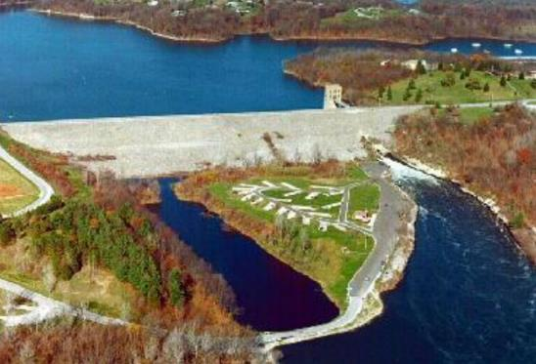
Effects of Sedimentation on project operating purposes (1959-2008)
Flood Risk Management
Low-Flow Augmentation/Conservation

Slide 20
Effect of sedimentation on flood risk management
Utilized a reservoir simulation model to evaluate the impact of sedimentation on peak reservoir elevations and downstream releases.
Analyzed 72 years of flow data.
Only change between simulations was the reservoir storage curve – comparison of 1959 and 2008 capacities.

Slide 23
Effects of Sedimentation on project operating purposes (1959-2008)
Flood Risk Management
Low-Flow Augmentation/Conservation
Original (1948) design called for 17,000 acre-ft of conservation storage.
Due to observed droughts, prior to construction completion this was increased to 53,750 acre-ft
2008 surveyed conservation pool capacity is 23,800 acre-ft.
Impact of sedimentation is to reduce the reliability of meeting future drought demand for conservation and downstream water supply.

Slide 24
Where are we going in the next 10 to 20 years?
Barring future management actions, we can expect:
Historic sedimentation rates to continue
Continued downstream migration of delta – further impacting access to middle and upper portion of lake
Continued loss of reliability in ability to meet drought demand
Slow degradation of flood risk management benefits
Opportunities
Section 1122 of the 2016 WRDA – beneficial use
Sustainable Reservoir Management Initiatives within USACE and BoR
Pilot Projects

Slide 25
Sustainable Reservoir Sediment Solutions
Reduction of sediment loads reaching the reservoir
Prevention of sediment deposition within the reservoir
Removal of sediments already deposited in the reservoir
Combination of the above strategies
Can be Less Expensive than No Action (depending on project benefits)

Slide 26
Is Dredging a Practical Solution?
Average sedimentation below spillway is 1620 acre-ft/yr
(780 acre-ft/yr in flood storage)
To break even (i.e., not recover storage), would need to dredge this every year!
Assuming a cost of $10/cubic yard for dredging (does not include costs for transport of material any significant distance or purchasing land to dispose of the material), this would cost $26.1 M/year.
($12.5M/year for flood storage only)

Slide 27
